Slide 1
Virtual Lab presentation
Simple illustration of use cases of the project

Slide 2
Submitted By:-
- Omar AbdelNasser Ibraheem 404077
- Yusuf Ashour Abdelrahman 404145
- Ammar Mahmoud Mohamed 404074
- Abdalla Ehab Salem Matar 404066
- Yasser Ahmed Ahmed Issa 404139

Slide 3
Topics discussed :-
Abstract
Why virtual labs ? (Motivation)
Users who can use that chemistry virtual lab.
UML
Use Cases
Why Unity
Figma Design
Unity Work
Back end work

Slide 4
Abstract
Practical laboratory courses are an essential part of chemistry education. However, they can be costly and time-consuming. They also require physical presence of the teacher and students and access to well-equipped laboratories, which can be hindered due to equipment cost or a pandemic lockdown.
Virtual chemical laboratories are digital tools that become very useful in these situations.

Slide 5
Why virtual labs?
Virtual labs can provide a place where any number of students can attend unlike practical labs.
Teachers can easily explain complex theoretical concepts to students through a visual experience that can make it simpler for students to understand.
Students can try various kinds of experiments in a virtual laboratory without the risk of injuring themselves or damaging equipment.
Students can learn at their own time and place.
V labs are far less expensive compared to the real ones. One single lab platform can serve an entire school.

Slide 6
Conclusion
Limitations of traditional labs:
Time
Money
Equipment availability
Safety concerns
Virtual lab exercises can nearly eliminate all these concerns!

Slide 7
Type of users
Teacher :
Functionalities:
Create an experiment
Provide a video or animation to explain the experiment and how the student can do it.
Student:
Functionalities:
Watch the animation provided by the teacher.
Do the experiment as the teacher explains.

Slide 8
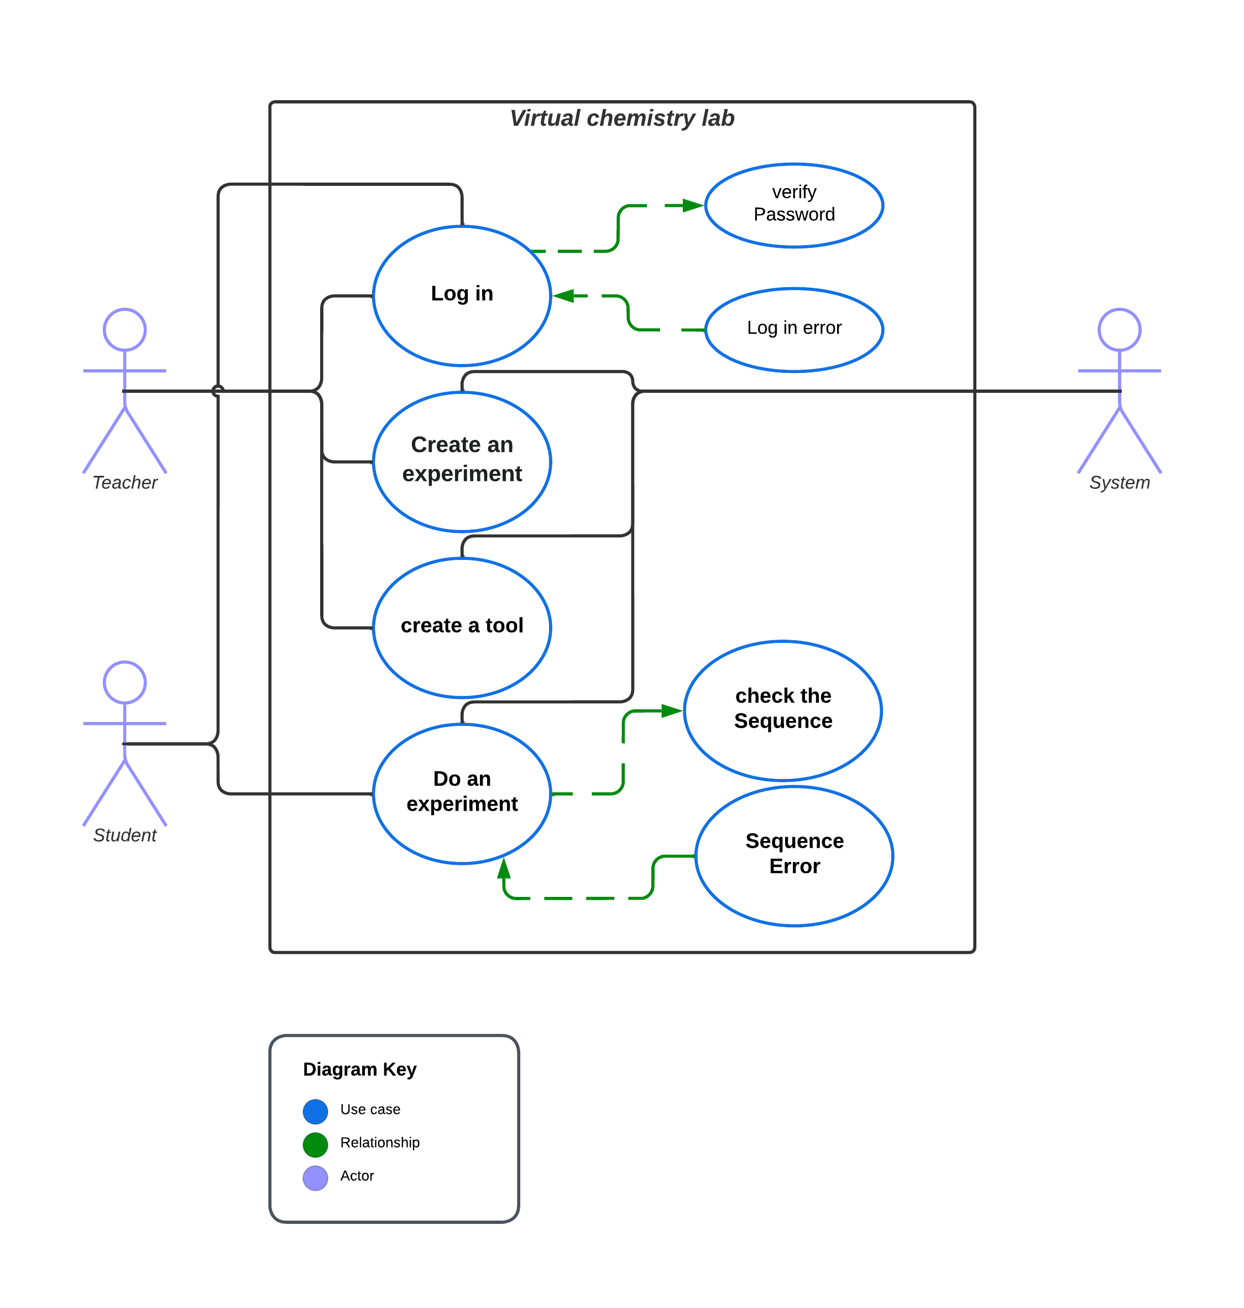

Slide 9
Use cases
Both teacher and student have an account so they will login at the beginning to restore their last session data
Teacher can create a brand-new experiment or use an existing one
Student just do the experiment that teacher has chosen
After the student do the experiment, the system will verify if the student did it as the teacher did or not

Slide 10
WHY uNITY
Definition : Unity is a cross-platform game engine can be used to create three-dimensional (3D) and two-dimensional (2D) games, as well as interactive simulations and other experiences.
Advantage of Unity :
1- Beginner-friendly : Easy to learn and use.
2- Cross-Platform Engine : More platforms supported
3- Unity has a more large and active community
4- Huge amount of assets ready to use
5- Packages Support
6- using C# .

Slide 11
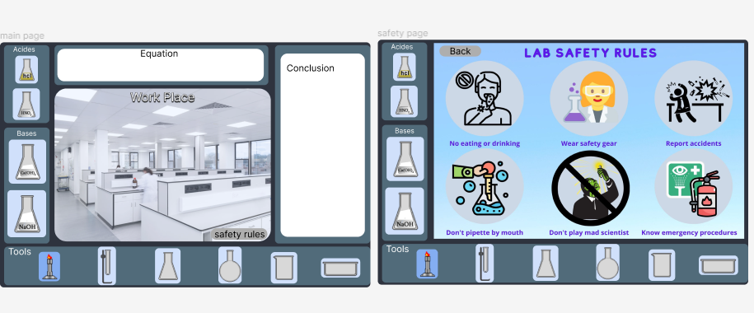
Figma Design

Slide 12
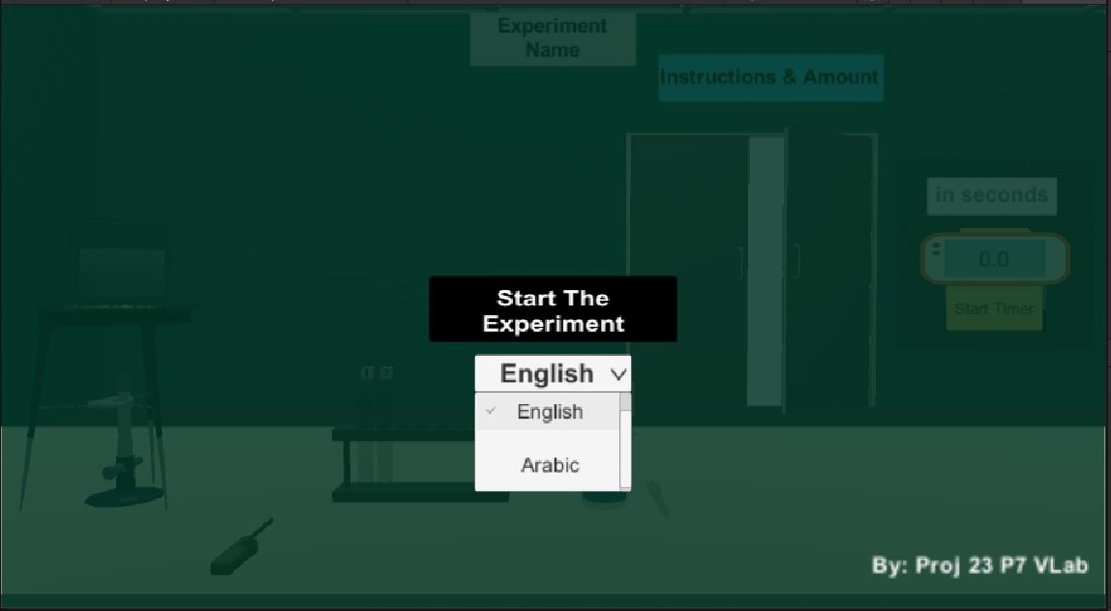
Unity Work

Slide 13
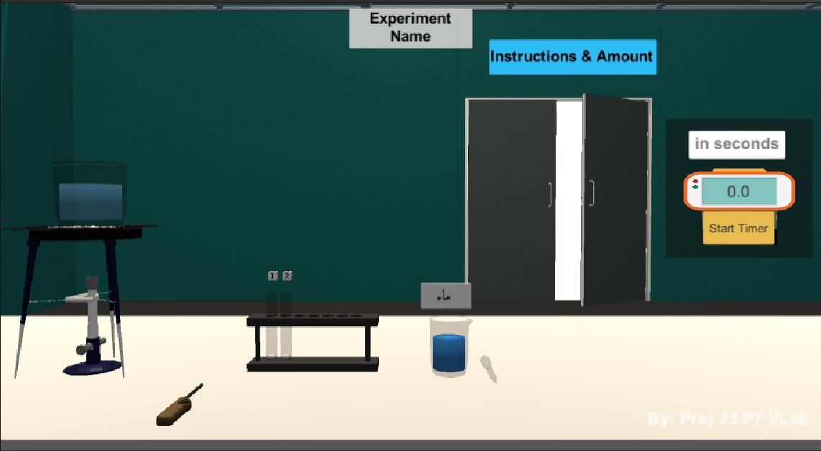
Unity Work

Slide 14
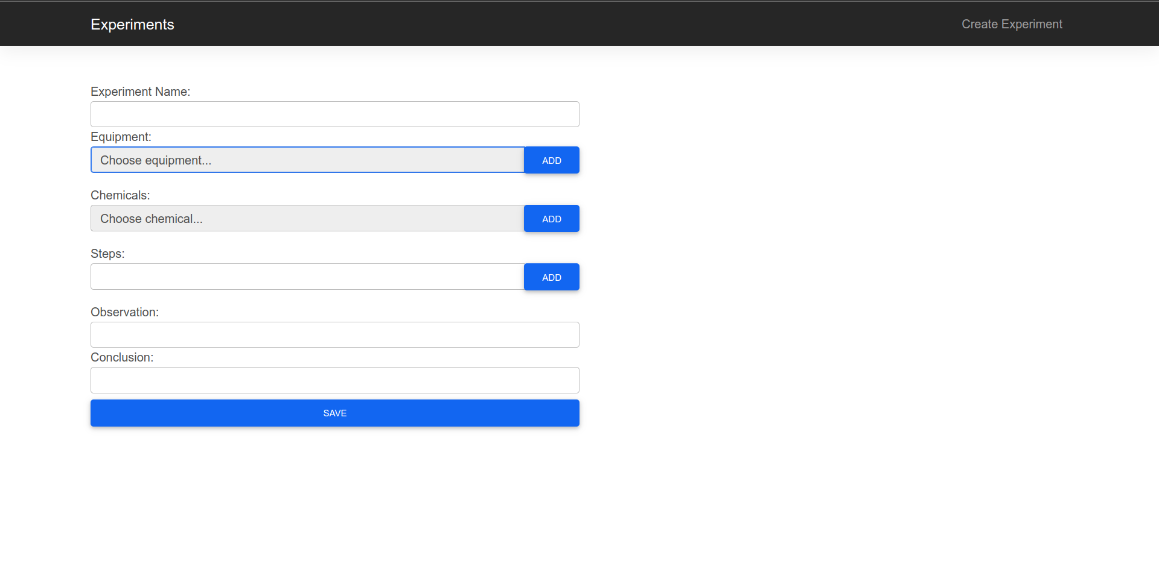
Backend Work

Slide 15
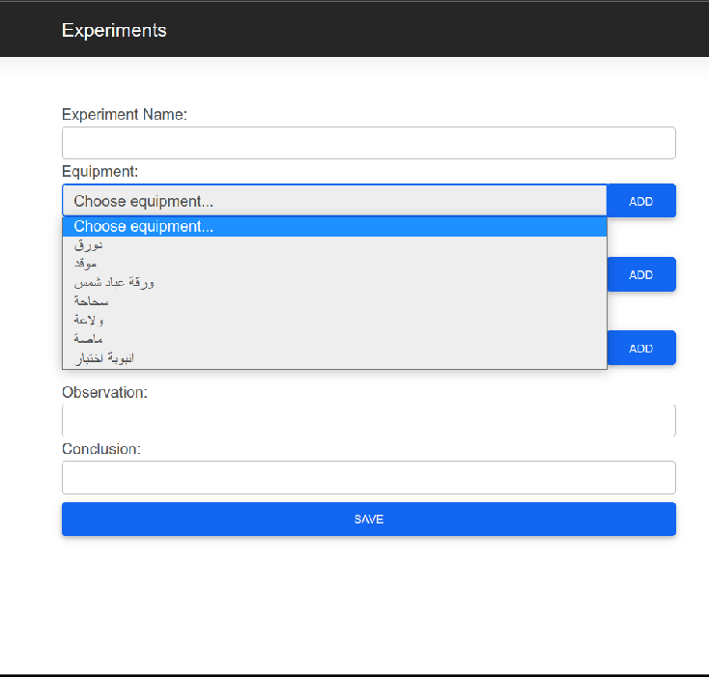
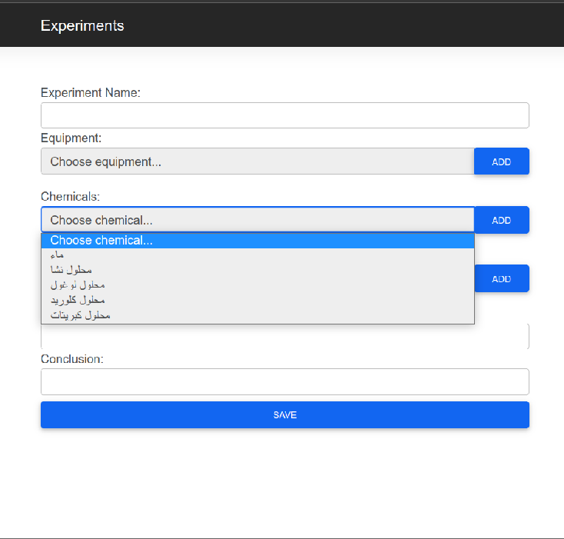
Backend Work

Slide 16
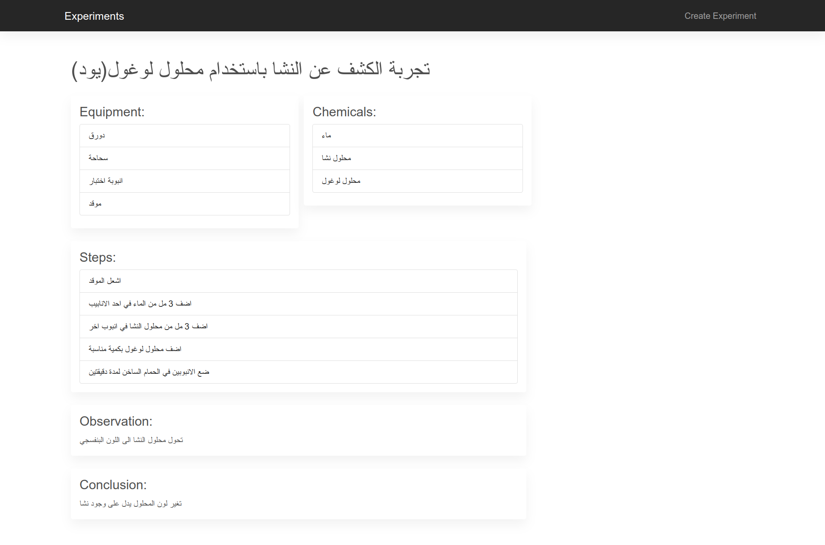
Backend Work

Slide 17
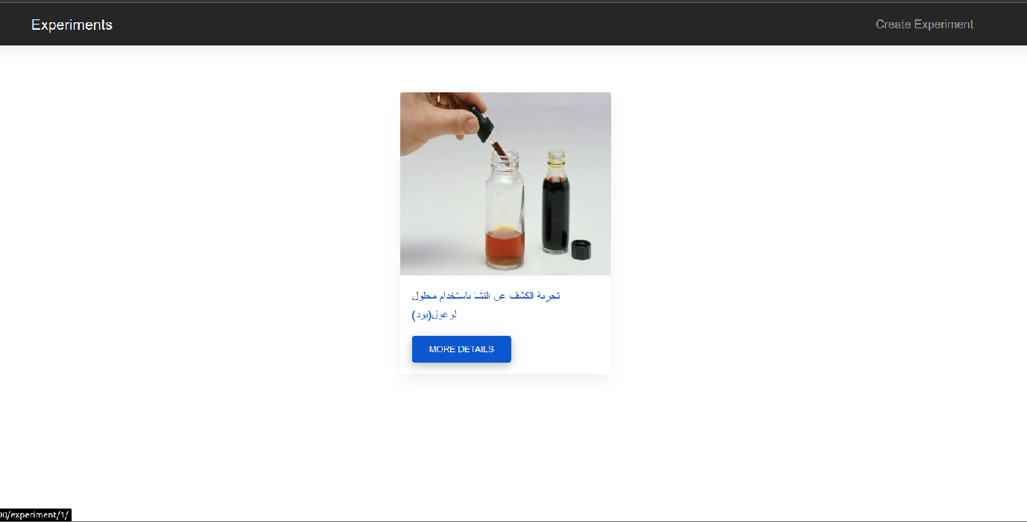
Backend Work

Slide 18
Thank you

